Slide 1
Risk Management, Cyber Security, and Professional Liability
American Board of Professional Liability Attorneys: National Legal & Medical Malpractice Conference
May 6, 2017
CompassPOINT Legal, LLC

Slide 2
Introductions
Douglas Chandler
Co-Founder, Chandler & Moore Law LLC, Atlanta, GA
ABPLA Diplomate
douglas@chandlermoorelaw.com
David Moon
Principal/Partner Lan-Tech, Inc. / Compass Point Legal, LLC, Atlanta, GA
20+ years in legal technology and information security
david@lan-tech.com

Slide 3
Cybersecurity or Cyberrisk Biggest Law Firm Risk in 2017
TruShield, an IT security company, reported in 2015 that the legal industry was the second most targeted sector for a cyber attack.
The TruShield 2016 report revealed that small law firms were now the most targeted.
Cravath/Weil-On March 29,2016, the Wall Street Journal reported that hackers had broken into the files of some of the biggest law firms in an insider-trading scheme that involved planned mergers. The press release linked the hacks to three foreign nationals who used information stolen from the firms for insider trading, gaining more than $4 million.

Slide 4
Cybersecurity or Cyberrisk Biggest Law Firm Risk in 2017, Cont.
Oleras—In February 2016, an alert went out to 46 law firms in the United States and two law firms in the U. K. that Ukraine-based hacker Oleras was advertising phishing services on a Russian website. According to the Wall Street Journal, this was related to the March 2016 breaches of several major law firms.

Slide 5
Lawyer Duties and Obligations Come From Where?
Clients pass their own obligations to their lawyers:
Consumer Financial Protection Bureau (CFPB)
New York State Department of Financial Services (NYDFS) recently promulgated cyber regulations for financial institutions that are likely to increase the risks to directors & officers (D&Os), resulting in an increase in claims.

Slide 6
Cyber Breach = Malpractice? Really?
On April 18, 2016, a New York couple filed a complaint against their real estate attorney based on their falling victim to a social engineering data breach.
The couple’s two-count complaint alleged claims for legal malpractice and breach of fiduciary based on their attorney's use of an AOL email account that allegedly contributed to cyber-criminals being able to hack into the attorney's account and perpetrate an elaborate wire-transferring heist of almost $2 million in the client's funds. Robert Millard, et al v. Patricia L. Doran.
https://www.scribd.com/document/309730357/NYC-Complaint

Slide 7
Law Firm Protection Planning, Investment, Training
Can no longer relegated to IT or General Policy
Part of Doing Business Everyday
Roadblock to Proper Preparation-- $$$$
Minimum Requirement—Up to Date Software
When problems occur must have a specific plan

Slide 8
Lawyer and Non-lawyer Training
Employees-- your weakest link?
Train annually and upon hire
Train on cybersecurity protocol
Train on spotting issues
Train on reacting to issues
Create anonymous hotline or suggestion box
Encourage open discussion – experiences, feedback, and ideas
Written policies and protocol – signature of acceptance
Reinforce THE USER is responsible

Slide 9
The A.R.T. of Risk Management
Avoid
Don’t undertake responsibility outside of your competency
Specifically define parameters for firm members
The ABA Cybersecurity Handbook: A Resource for Attorneys, Law Firms and Business Professionals will be published before the ABA Annual Meeting in August.
Cybersecurity for the Home and Office: The Lawyer’s Guide to Take Charge of Your Own Information Security, by John Bandler, Available July 2017, ABA Website
https://cybersecuirtyhomeandoffice.com/book and https://www.bandlerlaw.com/articles.html
Retain
Self-insure to a minimum with assessments, planning, and training
Invest in up-to-date assets
Transfer
Outsource to vendors
Purchase appropriate cyber coverage

Slide 10
Don’t Violate Rule 1.1 Competency- A.R.Transfer
David Moon
Principal/Partner Lan-Tech, Inc. / Compass Point Legal, LLC
20+ years in legal technology and information security
david@lan-tech.com Founding Partner
David graduated from Georgia Tech with an Master of Science –Electrical Engineer in 1993.
David started Lan-Tech, Inc., a company specializing in legal technology for law firms.
Certifications in Summation, Concordance, Time Matters, Billing Matters, Citrix, Tabs3 and Practice Master.
Awards include an STI Tabs3 President Circle Member. In 2005 he was named the Legal Technology Consultant of the Year (a life time achievement award).
David consults as an expert witness on computer technology and legal software topics.

Slide 11
Law Firms Under Attack
Security Experts say Hackers are targeting law firms.
80 of the 100 biggest firms in the country have been hacked
McKenna Long & Aldridge (now Dentons) lost Social Security numbers
Looking for potential corporate mergers, patent, trade secrets, litigation plans, personal information

Slide 12
Law Firms Under Attack
Law360 (Sept 22, 2015) – ABA survey has found 1 in 4 law firms with at least 100 attorney have experience a breach

Slide 13
Law Firms Under Attack
“Series of security breaches that struck prestigious law firms last year was more pervasive than reported . . .”
“The incident involved hackers getting into the email accounts of partners . . .”
Dec 7, 2016 – Fortune

Slide 14
Law Firms Under Attack
Many believe they are too small to warrant attack
Why would hackers go after us little guys?
Easy targets
Valuable information
Ability to pay
Not likely to report

Slide 15
Easy Targets
Citigroup, for example, recently told its employees in an internal report that law firms are vulnerable hacking targets because they are clearinghouses of high-value information and possess relatively weak security measures, according to The New York Times. The Citi memo also said that law firm security generally falls below the standards of other industries — and pointed to a reluctance by law firms to publicly disclose breaches and the absence of formal reporting requirements in the legal field as reasons for silence.
http://www.nytimes.com/2015/03/27/business/dealbook/citigroup-report-chides-law-firms-for-silence-on-hackings.html?_r=1

Slide 16
Security Attack – A matter of when
All systems are vulnerable – all systems will have some breach at some point!
In 2003, former FBI director Robert Mueller stated “There are only two types of companies: Those that have been hacked, and those that will be.”
What is your annual Security Budget?
Don’t have one?
Should be a separate line item beyond IT budget

Slide 17
Security Attack – A matter of when
The goal is to:
Minimize the risk
Minimize the damage
To know what was accessed.
Some software can audit all data access, by user and when. Great tool for knowing what was breached and the extent of damage.

Slide 18
Client Security Assessment
2016- 30.7% of all law firms and 62.8% of firms over 500 lawyers report clients provide security requirements
Corporate clients are requiring law firms to complete security assessments
Email Encryption
Storage of data
Written policy to handle breach
Employee policy/training

Slide 19
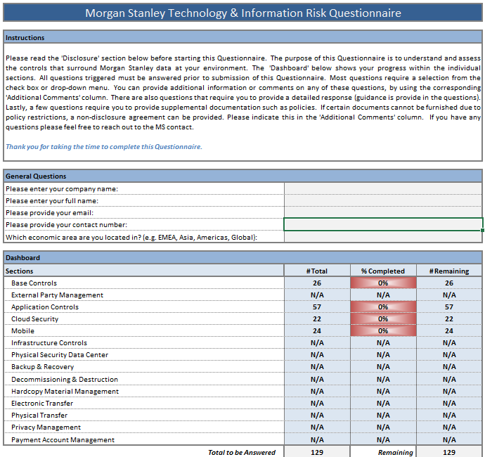
Morgan Stanley Sample Questionnaire

Slide 20
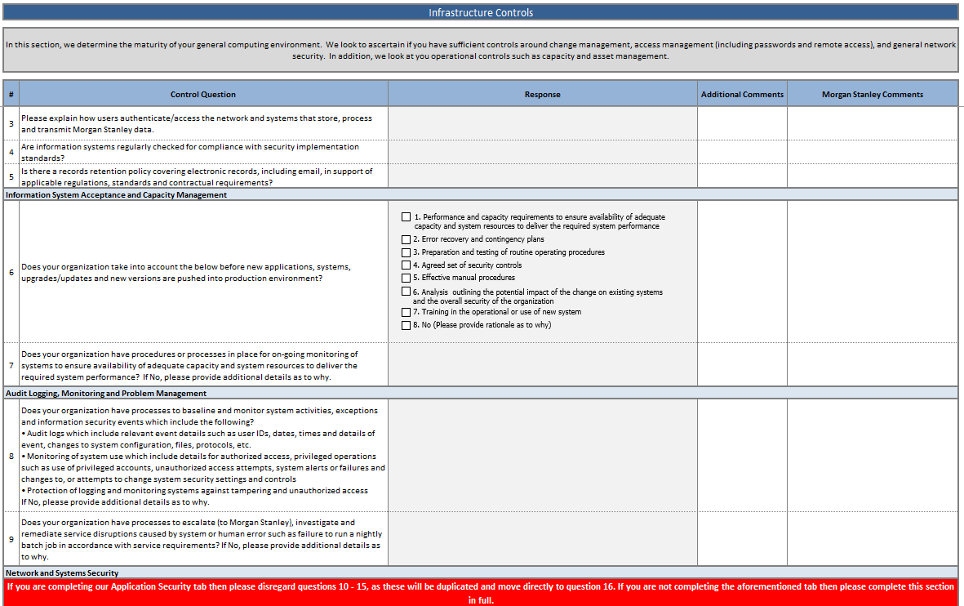
Morgan Stanley Sample Questionnaire

Slide 21
Law Firms Under Attack
Cyberinsurance
Market is relatively small and new
Are there any requirements?
Security audits
Reasonable care

Slide 22
Hacking is a big business
Why are they attacking law firms?
Corporate Espionage
Selling/using personal information
Ransom
Blackmail

Slide 23
Ransomware
CryptoLocker / Cryptowall
What is it?
How do you get it?
Trying to prevent it
New Variations
Fear is one day it will run for days before announcing itself
Pay the ransom or Restore – Only options

Slide 24
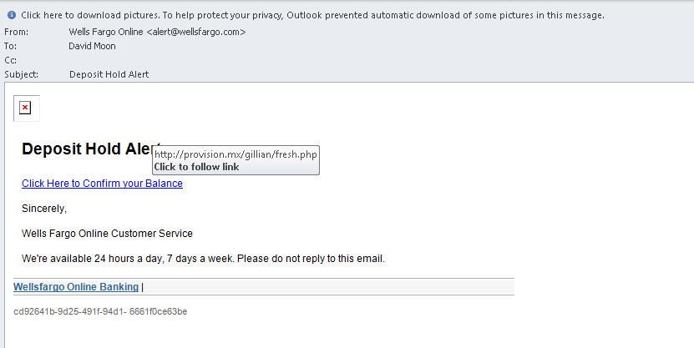
Hackers Go Fishing

Slide 25
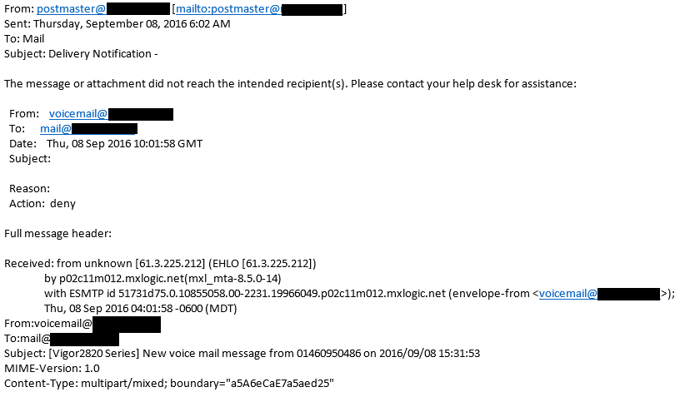
Example of spoof email

Slide 26
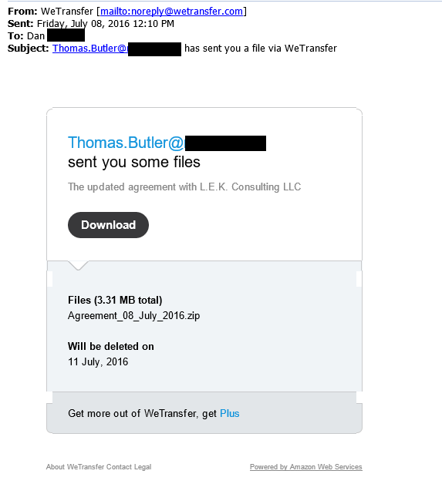
Example of spoof email

Slide 27
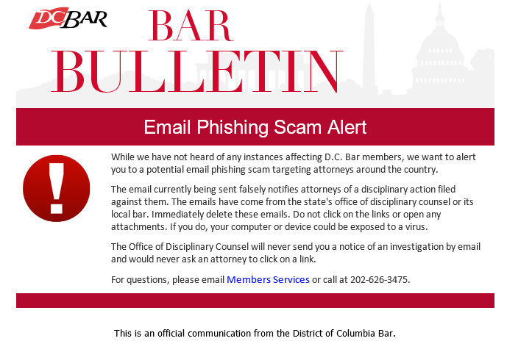
Example of spoof email

Slide 28
Silently Steal Data
Dear Law Firm,
We have a copy of all your client’s data. To prove we have a copy, here is some of the files we have.
Unless you pay us this amount of money, we will publish ALL of the firms data which includes your clients confidential data, to public servers for the world to see.
Notes:
Ashley Madison. Sony Corporation - Movie

Slide 29
Rules of Professional Conduct
Rule 1.6, Confidentiality of Information, states that lawyers shall not disclose private information and shall make reasonable efforts to prevent any such disclosures.
What are Reasonable Efforts?

Slide 30
Unique Professional Responsibility
What if you had a breach of a client’s files, and that breach involved personal information of the client’s customers?
Codes of ethics generally dictate that attorneys must not reveal information related to the representation of clients, and must make reasonable efforts to prevent unauthorized access to client secrets. Firms that suffer security breaches face questions about what steps they took to meet the latter obligation, while the act of disclosing the breach itself challenges the confidentiality demanded of the former.

Slide 31
State Laws on Disclosure of Data Breach
Forty-eight states, the District of Columbia, Guam, Puerto Rico and the Virgin Islands have enacted legislation requiring private or governmental entities to notify individuals of security breaches of information involving personally identifiable information.
http://www.ncsl.org/research/telecommunications-and-information-technology/security-breach-notification-laws.aspx

Slide 32
Road To Protection
Education
Attorneys and Staff
Written standards
No one should be above requirements or exempt
Educating new hires
Client
Communication with clients
Email Encryption

Slide 33
Social Engineering Hacking
People are the weakest link
Easily tricked into giving up information or opening the door
Running a backdoor
Security questions for forgot passwords
Trust No One!

Slide 34
Passwords
The obvious is still overlooked
Min 8 Characters – Randomize
P@ssw0rd is no longer acceptable
Use different passwords from other systems such as Social Media, Banking, Etc

Slide 35
Fishing/Spoofing Emails
Cannot stop someone from sending out emails pretending to be from you or appearing to come from someone you know
Email sender address easily faked
Be suspicious of attachments (Not expecting, never open)
Even encrypted email can be faked (has link to log in)
Test peoples awareness and following the rules

Slide 36
Not work related – stay off
Social Media attacks – i.e. Facebook
Breach is typically from all the links to other pages
Friend Request should be under scrutiny

Slide 37
Protection vs Publicity
Firm Web – What information are you giving out
Hackers targeting your client with search the web and target the firm.
Yes, information could be gathered from Court documents
Attorney Email address – Also obtained from Ga Bar web site
Spoofing an attorney email address allows for each breach.

Slide 38
Email Breach
Breach is difficult to detect
So many devices connect and ways to connect
Outlook on PC
Web Access
Smart Phone
Tablet

Slide 39
Email is not a long term storage
One breach email account can compromise TENS of THOUSANDS of emails going back many years
Any confidential documents should not be attached to email – but we all do it.

Slide 40
Smart Phones
Password protect your phone
Setup a remote wipe feature if your phone is lost or stolen
Change your email password
New security attacks are possible through unopen text messages (Stagefright)
Do not install apps that are not needed
Only install apps from the App Store
Ad producing apps make it possible for other apps not going through the apps store
Setup firm policy for users the use a personal phone to access email and other firm resources.

Slide 41
Laptops and USB Drives
All easily stolen storage needs to be encrypted.
Laptops can have tracking software installed with remote wipe features.
Avoid coping data to Laptops and USB drives.

Slide 42
Secure Your Offices
High rise office buildings are as vulnerable as the private office space – maybe more vulnerable
Secure your Severs
Locked server room
Cameras
Log off your computers when leaving
Lobby / reception area should be secured from the rest of the office

Slide 43
Secure Your Office
Placement of computers and monitors
Monitor should not be visible from any guest sitting area or window
Keyboard should not be visible when others are present (typing a password)
Computer should not be accessible by others (computer on the side of desk / front or back – Keyboard loggers can be connected easily.
No one should be left alone where there is a computer or even a network connection.
WiFi with strong encryption. Guest WiFi should be isolated from network.

Slide 44
Home Access to Office Computer and Data
Home computers may be the biggest weak link.
Remote Node connections (VPN) which the home computer has a direct connection to server drive can unleash ransomware or cause data breach.
Remote Control connections will isolate remote (home) computer better – Citrix/Terminal Sever, LogMeIn, GoToMyPC.
Home computers could have keyboard loggers which grab user names and passwords.

Slide 45
Cloud Computing – Secure or Not
Many myths about Cloud Computer Security
Know the cloud vendor
One who specializes in legal
Much (Not All) of the security is shifted to the Cloud vendor. But, is liability shifted?

Slide 46
New Ransomware Attack
Using RDP and weak passwords
Some compromised TeamViewer accounts (IT providers) have been used to spread attacks

Slide 47
Cloud Computing
Some Cloud Services could actually introduce vulnerabilities.
Can Dropbox create a security hole?

Slide 48
State Bar - Cloud
ABA list state bars who have issued opinions
http://www.americanbar.org/groups/departments_offices/legal_technology_resources/resources/charts_fyis/cloud-ethics-chart.html

Slide 49
Cloud Computing Ethics Opinions
ALABAMA Opinion 2010-02
Use Permitted: Yes
Standard: Reasonable Care
Requirements and Recommendations:
Know how provider handles storage/security of data.
Reasonably ensure confidentiality agreement is followed.
Stay abreast of best practices regarding data safeguards.
https://www.americanbar.org/groups/departments_offices/legal_technology_resources/resources/charts_fyis/cloud-ethics-chart.html

Slide 50
Security is never finished
Securing your firm’s and your clients’ information is an ongoing initiative, the strength of which lies with each individual user.
Consult, Design, Implement, Train, Repeat

Slide 51
When Problems Occur - Respond
Don’t panic, but also don’t stick your head in the sand!
Consult the firm’s plan
Appropriate, timely response to carrier and client is critical
Communication is critical, but not necessarily from you
Seek competent advice
Read your policy

Slide 52
Contact Information
Douglas V. Chandler, Chandler & Moore Law, LLC
douglas@chandlermoorelaw.com
770-751-8050
www.chandlermoorelaw.com
LinkedIn Group: bit.ly/attorneyethicsgroup
David Moon, Lan-Tech, Inc. / CompassPOINT Legal, LLC
david@lan-tech.com
770-514-0400 x212
www.compasspointlegal.com

Slide 53
Thank You!

